Slide 1
CROWD FUNDING

Slide 2
Introduction to crowdfunding
Crowdfunding is when many people contribute small amounts of money to support a project, idea, or business.
It's mostly done online.
Types of Crowdfunding:
Donation-based: People donate money without expecting anything in return (like for charity).
Reward-based: People give money and get something in return (like early access to a product).
Equity-based: People invest money and get shares or part-ownership in the company.
Debt-based (Lending): People lend money and expect to be paid back with interest.

Slide 3
Benefits and Challenges:
Benefits :
You can raise money without needing a bank or big investors.
It helps you test if people like your idea.
It can help build a group of supporters or future customers.
Challenges:
You need good marketing and people to support your project.
If you don’t reach your goal, you don’t get any money

Slide 4
What is Kickstarter ?
Kickstarter is a popular website where people can raise money for creative projects like art, music, technology, and games.
Work flow:
Create a Campaign: Share your idea and funding goal.
Funding Goal: You only receive funds if your goal is met.
Rewards: Donors get rewards (like early access to products or special perks).
Features:
All-or-Nothing: If you don’t reach your goal, no money is collected.
Global Reach: Available worldwide.
Creative Focus: Ideal for innovative and creative projects.

Slide 5
Project Overview
Key Details:
Total Projects Analyzed: 365892 projects.
Average total projects based on location : 23252
Total Amount Raised: $1.6041 Million
Average Funding Duration: 79 days
Total Backers: 4,291

Slide 6
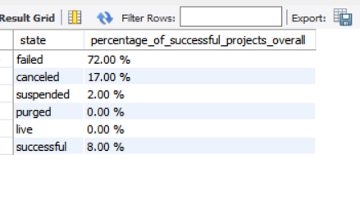
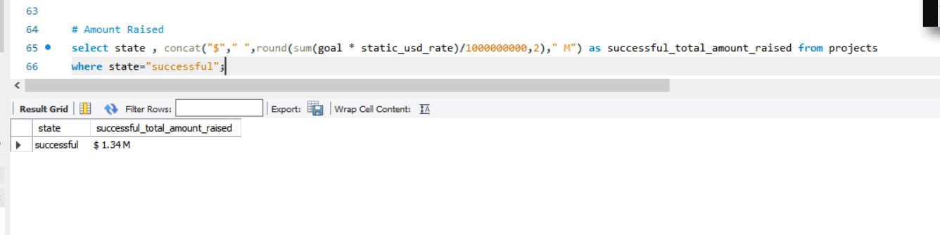
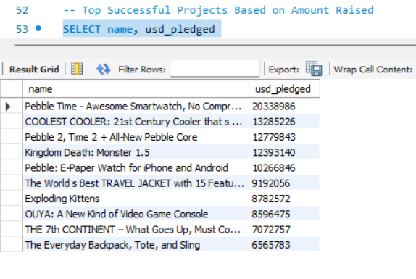
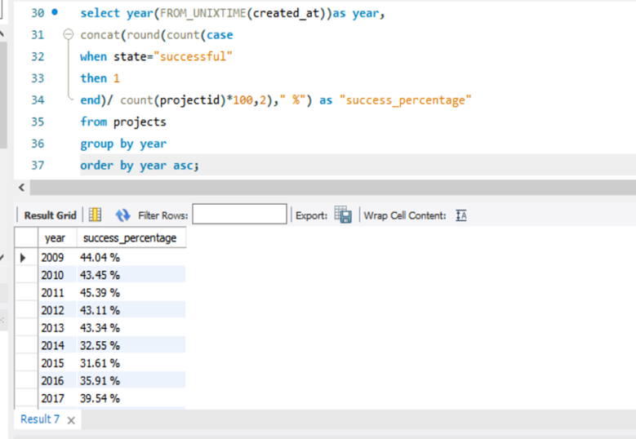
Top Successful Projects with overall percentage

Slide 7
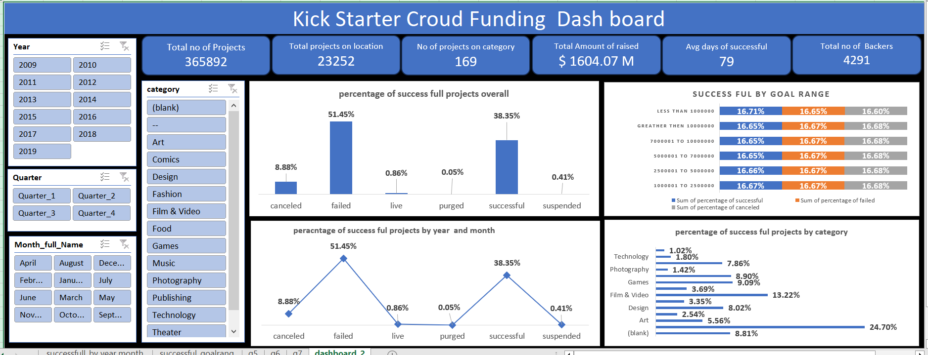
Excel Overall Dashboard

Slide 8
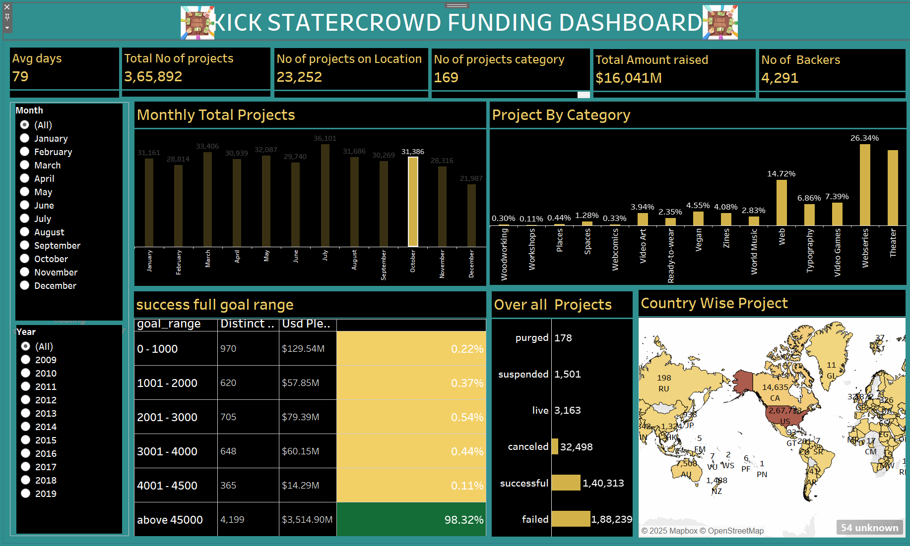
Tableau Dashboard

Slide 9
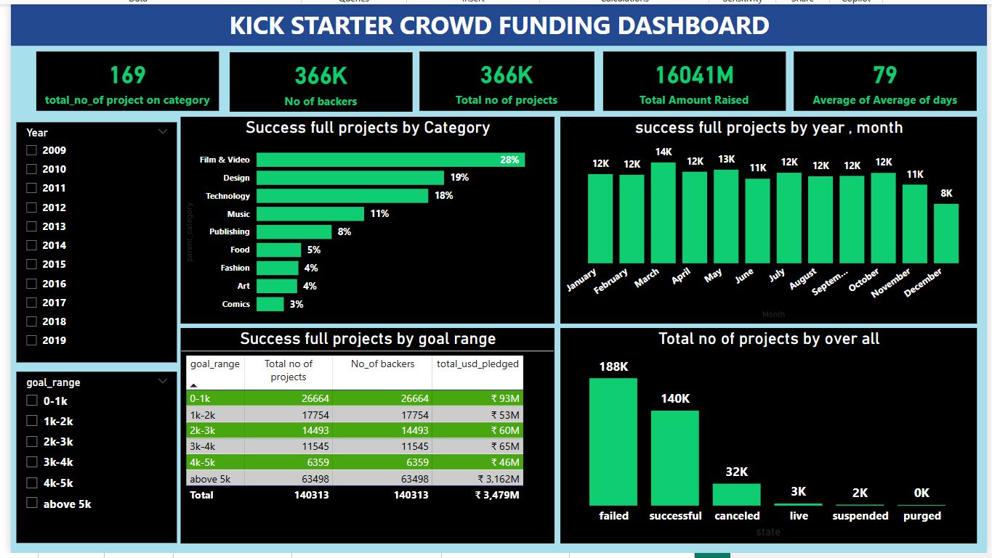
POWER Bi Dashboard

Slide 10

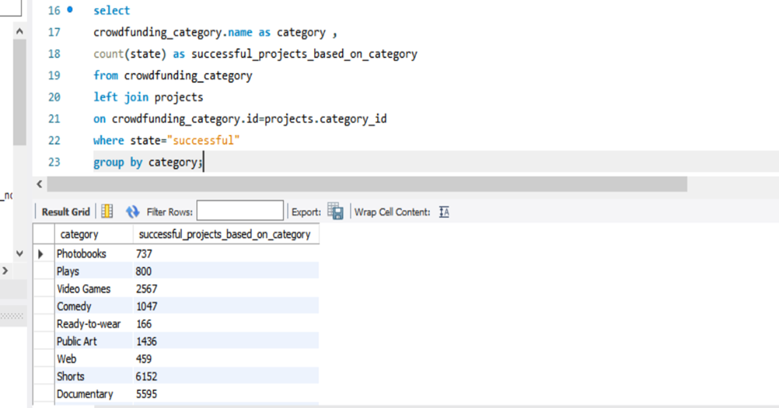


Slide 11
Challenges & Improvement Areas
Common challenges:
High Competition & Market Saturation
Thousands of projects launch daily on platforms like Kickstarter & Indiegogo. Standing out is difficult.
Reaching the Right Audience
Trust & Credibility Issues
Improvement Areas
Strong branding, compelling storytelling, and a well-structured campaign
Leverage social media, email marketing, influencer partnerships, and targeted ads.
Show transparent budgets, realistic timelines, prototypes, testimonials, and previous successes.

Slide 12
Summary of Key Insights
Crowdfunding has proven to be a powerful tool for raising funds and engaging communities.
Successful projects are built on strategic marketing, strong storytelling, and transparent communication.
The most effective campaigns leverage social media, influencer marketing, and well-structured reward systems.

Slide 13


Thank you

